Slide 1




Weakly supervised learning of point-level annotation for coral image segmentation
Xi Yu

Slide 2
Project Background
HBOI (Reed et al.) has conducted baseline characterizations of coral reefs in the Gulf of Mexico and the southeastern US.
Images of the regions of interest were acquired using Remotely Operated Vehicles (ROVs) during the cruise and are then analyzed to quantify the coral abundance.
The current manual analysis are time-consuming and labor intensive
~16 man-weeks to analyze images from one typical two-week cruise.
Objective: Developing an automatic way to do coral images segmentation by using only sparsely labeled data set.

Slide 3
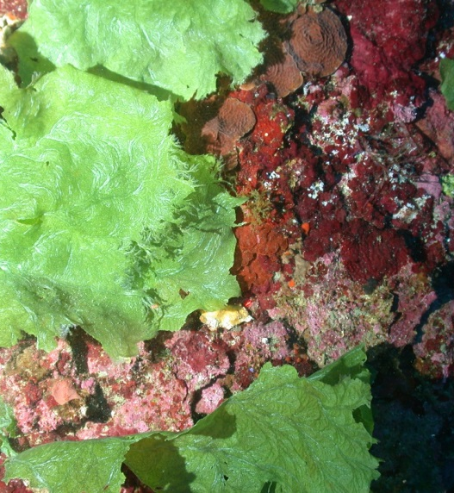
Challenges and opportunities
The size of image is large, which is 2048*1536, it will be very slow to do image segmentation.
The image is clutter with many species
Complex scene and challenging conditions –mixture of coral, algae, and sponge, pavement etc. coupled with camera/lighting variations…
Sparsely labeled Dataset
labels are very sparse (only 50 pixels are labeled per image)
All state-of-the-art deep learning-based models require a large amount of good quality labels which is highly costly and tedious to obtain.

Slide 4
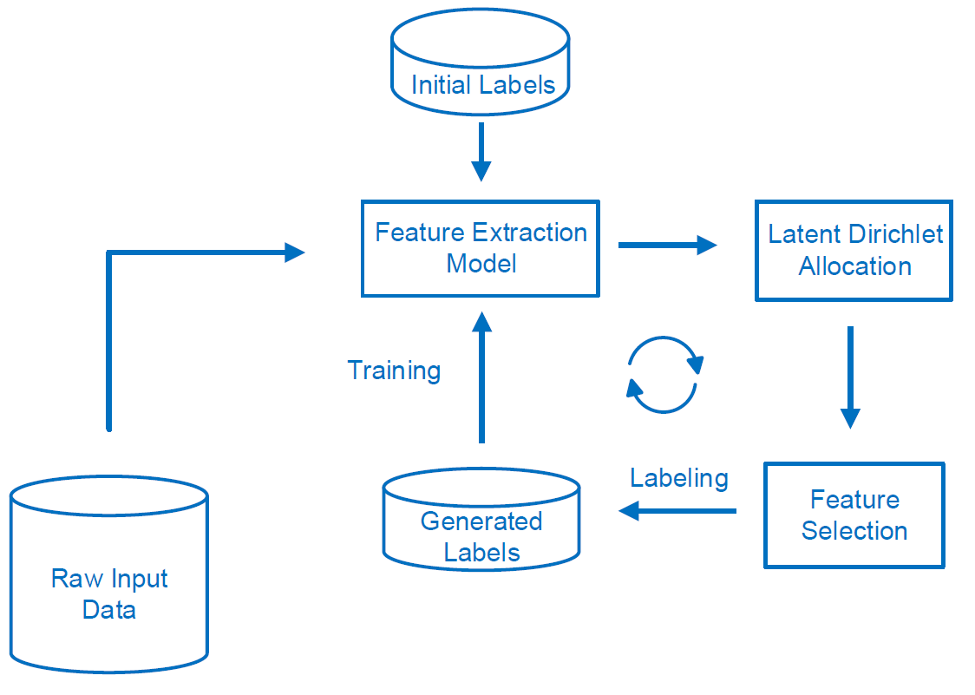
Diagram of Framework
Notes:
In this slide, we introduce what’s the Latent Dirichlet Allocation and how we use it in our image segmentation problem. We assume that every image is composed of many categories and for each categories, there are exist distribution over the different image features.

Slide 5
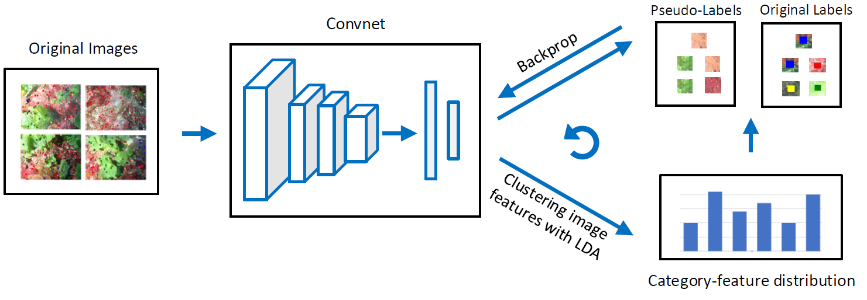
System Overview
Developing an iteratively label generation algorithm by using sparse training data.
Notes:
The framework of image segmentation with point-level supervised learning is shown in above.. Initially, the CNN model is per-trained with only original sparse labels.
Then we use LDA model to find the latent distribution of the different categories according to the features extracted
by CNN. After that, we select the higher probability features based on the category- feature distribution. Finally, we generate missing labels according to these features and add them in the training set to train the CNN model again.

Slide 6
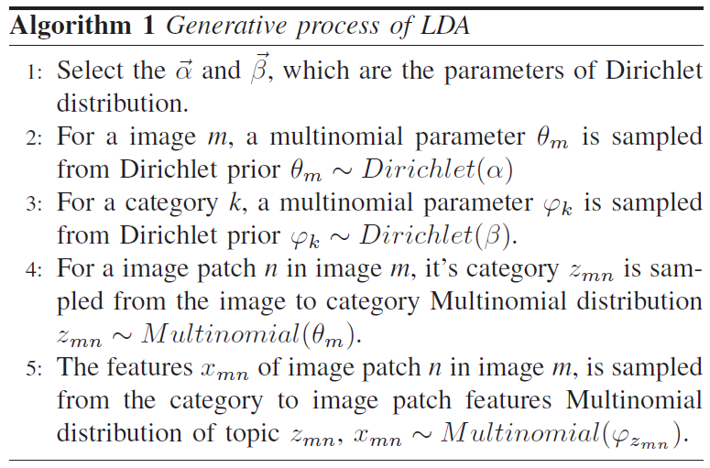
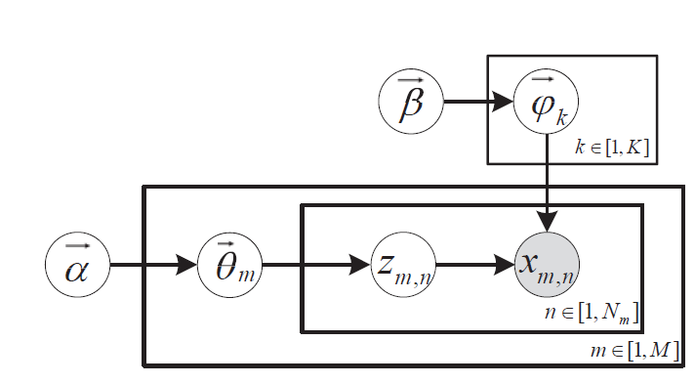
Latent Dirichlet Allocation (LDA)
Notes:
In this slide, we introduce what’s the Latent Dirichlet Allocation and how we use it in our image segmentation problem. We assume that every image is composed of many categories and for each categories, there are exist distribution over the different image features.

Slide 7
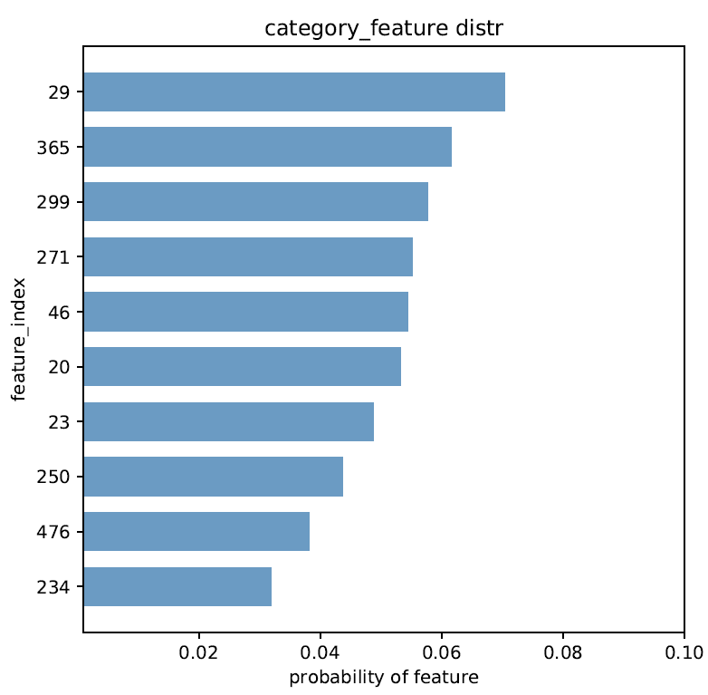
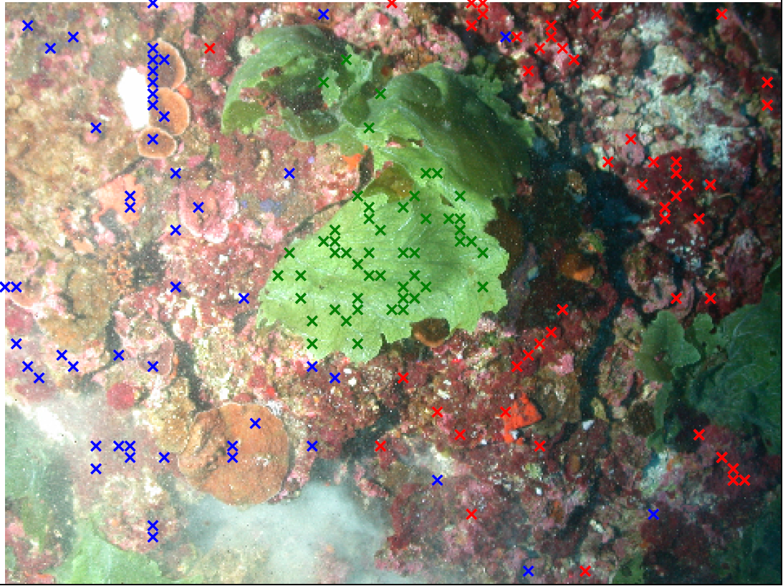
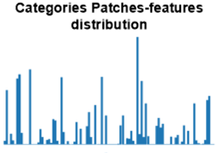
Features selection and labels generation
Ranking the features based on their probability
Go through the whole image and find image patches which have the similar category features and label them.
Get categories patches features distribution by LDA
Select the higher probability features as the feature of that category.
Notes:
In this slide, we introduce the way how we select features based on the Latent Dirichlet Allocation. We first use LDA to get the latent category distribution, and then rank all the features according the probability in the category-feature distribution. Finally, we come back to the original image to find the image patches which have the similar features as we selected.

Slide 8
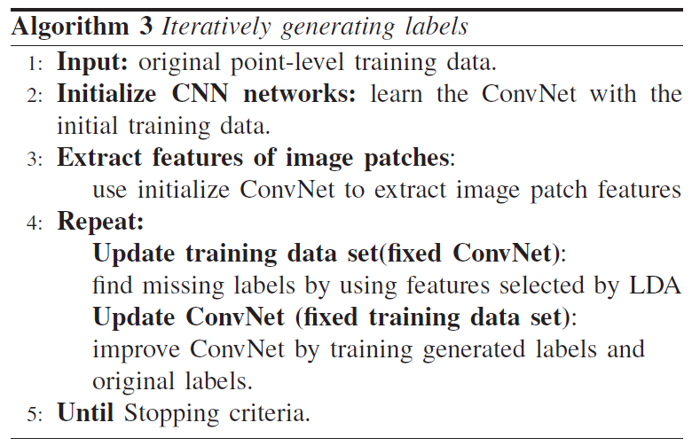
Generate labels iteratively
Step1: Finding corresponding category for each clustering generated by LDA.
Step2: Regarding image patches which have similar features selected by LDA as our labels.
Step3: Adding generated labels in training set and train CNN model again. Using features extracted by new CNN model and cluster them by LDA and repeat step1 and step2.

Slide 9
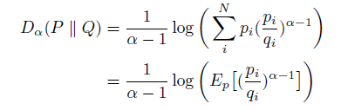
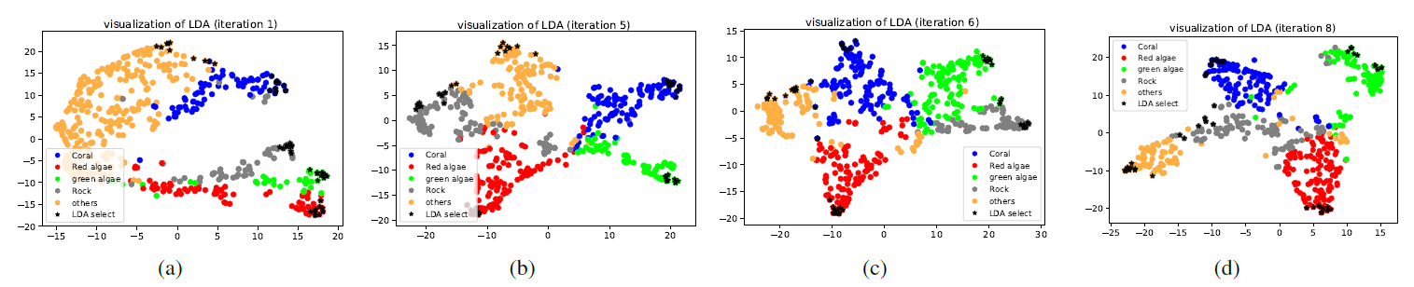
Results
In order to quantify the clustering quality in each iteration, and we use renyi’s alpha divergence as the stop criterion to our framework, the equation is shown as follows:
The following figures show the clustering in the feature space for different iteration, different colors represent different categories. We also find that the features selected by LDA are located at the edge of the cluster, which is making sense because the points at the edge of the cluster are far away from other clusters and are more likely to belong to that cluster.
Notes:
In this slide, we visualize the features clustered by LDA in different iteration, as we can see the quality of the clustering become better iteration by iteration. Because, when we add more labels into training set, CNN can extract more accurate features and LDA can work better than before. We use Fisher ratio to quantify the quality the clustering, the formula is shown above.

Slide 10
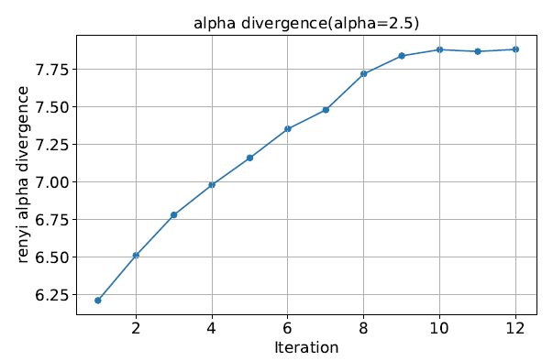
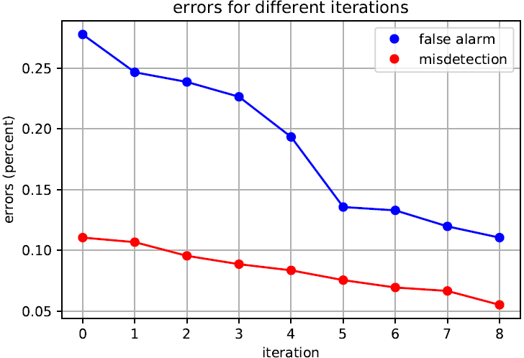
Results
Figure(a) shows the value of Renyi’s alpha divergence between the clustering in each iteration. As we can see, the value becomes larger iteration by iteration and stable after 8 iteration, which means our model converge in the final. The change of misdetection error and false alarm error for each iteration are shown in Figure(b).
Notes:
In this slide, we show two figures during the training. Figure(a) shows the Fisher ratio for different iteration, as we can see the value become larger iteration by iteration, which means the quality of the clustering is better and the features extracted by CNN became more separable. Figure(b) shows the errors during the training, the false alarm and misdetection curve decline both during the training, which means the accuracy of the results are also improve. We can see after 6 iteration when the number of the labels reach to 20000, the curve in the figure become stable, which means our model converge in the final.

Slide 11
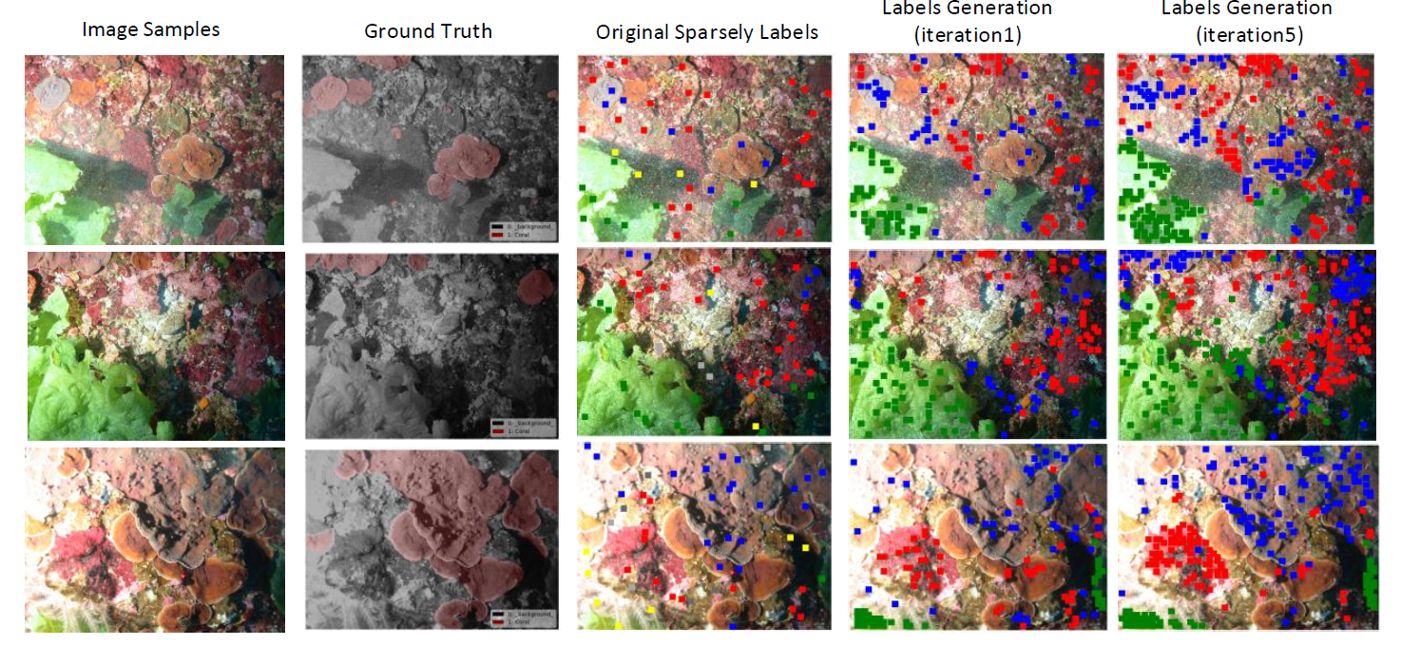
Results
Notes:
In this slide, we visualize the features clustered by LDA in different iteration, as we can see the quality of the clustering become better iteration by iteration. Because, when we add more labels into training set, CNN can extract more accurate features and LDA can work better than before. We use Fisher ratio to quantify the quality the clustering, the formula is shown above.

Slide 12
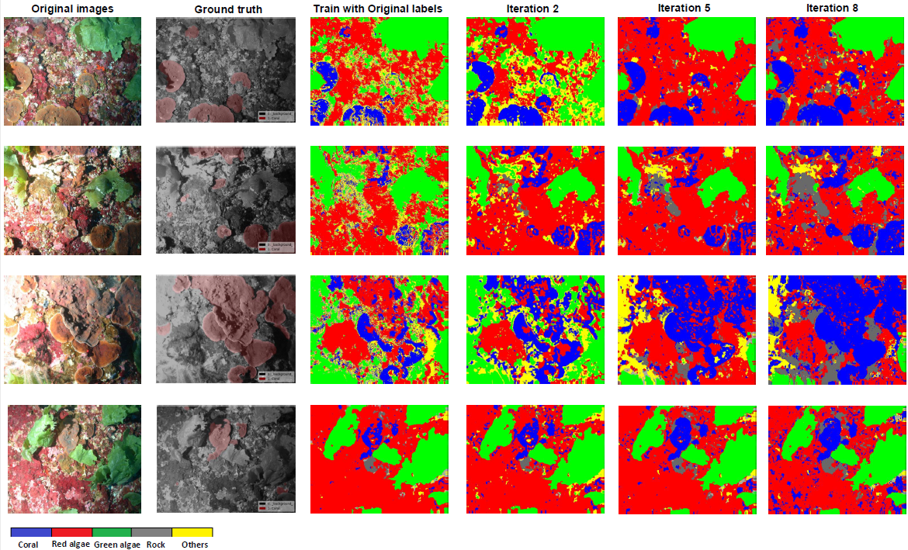
Results
Notes:
In our coral image data set, there are 120 images with only 50 labeled pixels for each image, the size of each image is 2048 × 1536. The number of original point-level pixel labels
is 6000, and the labels we generated for each iteration is 2000. Then we combine generated labels and original labels together to train the CNN networks, we use 70% for training, 30% for testing. The figures in the slide show the results of coral images segmentation in the different iteration, the first column represents the original sample images and the images in the second column denotes the ground truth, the third column to the fifth column are the results of different iteration respectively. Obviously, the result with larger iteration can perform better than with small iteration because the features extracted by CNN will be more accurate iteration by iteration.

Slide 13
Conclusion
We propose a simple yet effective framework to do image segmentation with weakly supervised learning based on the sparsely point-level labels.
Unlike most previous weakly supervised methods, our approach does not rely heavily on off-the-shelf techniques, our framework can generate labels itself and train the CNN models iteratively.
Experimental results on coral image data set collected in Pulley Ridge region from the Gulf of Mexico show that our iterative label augmentation method outperforms previous models trained by the same level of supervision.

Slide 14
Future Work
We will compare other methods to quantify the unlabeled data according to the labeled data information, like the Bayesian Neural Network.
We will apply our method on the public image segmentation data set like PASCAL VOC data set.
We want to using some information theoretical methods in our inference loop for unlabeled data set.

Slide 15
Thank You

